Slide 1
Federal Consistency in the CNMI
Sept 2020

Slide 2
Disclaimer
This PowerPoint is meant to be an introduction to Federal Consistency and not offer official guidance.
Please refer to the regulations contained in Coastal Zone Management Act §307 (16 U.S.C. §1451) for legal authority.
Contact FedCon@dcrm.gov.mp for more information.

Slide 3
What is Federal Consistency?
A provision of the Coastal Zone Management Act (CZMA) which gives states a voice in federal agency decision making.
The CZMA says any federal action, which will affect any land or water use or natural resource in the CNMI’s coastal zone, must comply with the enforceable policies of the CNMI’s coastal management program.

Slide 4
What is a Coastal Management Program?
TheDivision of Coastal Resources Management (DCRM) oversees the CNMI’s Coastal Management Program.
The Coastal Management Program is approved by NOAA.
The goal of the Coastal Management Program is to balance development and conservation in the CNMI in the most sustainable manner possible.

Slide 5
What are enforceable policies?
The CNMI has several laws pertaining to coastal management, conservation, and sustainable development.
NOAA approves some of these laws to be part of the Coastal Management Program. These are called enforceable policies.

Slide 6
CNMI Enforceable Policies
NMIAC Chapter 15-10
Public Law No. 3-47
CNMI Air and Water Quality Standards
Any additional policies, regulations, standards, priorities, and plans approved by NOAA-OCM

Slide 7
Why is Federal Consistency Important?
It gives the CNMI a chance to discuss federal projects with federal agencies.
It is an opportunity to highlight issues the CNMI has with federal projects and discuss areas of improvement.
Note: DCRM’s federal consistency contact works for the CNMI and not for a federal agency.

Slide 8
When does federal consistency apply?
Federal consistency review occurs for:
1: Federal Activities - when a federal agency’s own project may affect the coastal zone.
2: Federal Licenses and Permits - when a federal agency issues a license or permit for a project that may affect the coastal zone.
3) Federal Financial Assistance - when a federal agency provides funding for a project that may affect the coastal zone.

Slide 9
FC Reviewing Process
Identify action and category
Public Notice
Conduct review
Submit determination

Slide 10
NEPA vs. CZMA review
NEPA's basic policy is to assure that all branches of government give proper consideration to the environment prior to undertaking any major federal action that significantly affects the environment. CEQ notes: “…the ultimate goal of the NEPA process is to foster excellent action that protects, restores, and enhances our environment”.
Before a major federal action can be approved, the respective agency must first assess potential environmental impacts. Examples: power plants, airports, pipelines.
Review Process: 1) Categorical Exclusion Determination
2) Environmental Assessment/Finding of No Significant Impact
3) Environmental Impact Statement

Slide 11
Listed Federal Actions
The CNMI has identified federal actions that are reasonably likely to affect the coastal zone.
The list of federal actions subject to federal consistency review outlines these activities.
Any agency engaging in these activities must coordinate with DCRM to complete federal consistency review.

Slide 12
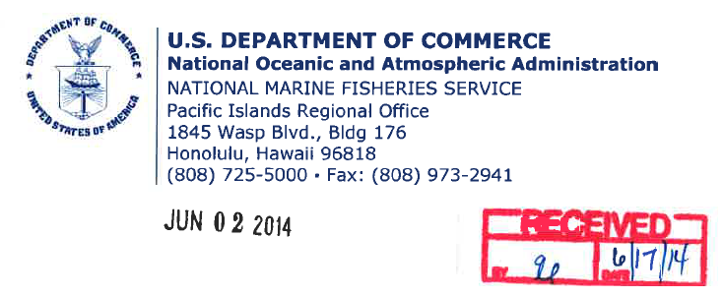
What are examples of Federal Consistency in the CNMI?
DCRM regularly reviews federal agency actions to ensure they are consistent with the CNMI’s Coastal Management Program.
Earlier this year, DCRM reviewed and issued a Final Consistency Determination of the Supplemental MITT with the Department of Defense

Slide 13
Where can I find out more about Federal Consistency?
Please visit the Federal Consistency page of the DCRM website for more information and guidance.
Contact Us at FedCon@dcrm.gov.mp

