Slide 1
Federal Consistency in the CNMI
Updated Sept 2015

Slide 2
Disclaimer
This PowerPoint is meant to be an introduction to Federal Consistency and not offer official guidance
It should not be relied upon as a substitute for the federal regulations applicable to federal consistency review
Please refer to the CZMA Federal Consistency regulations and the Coastal Zone Management Act, 16 U.S.C. §1451 for legal authority
Contact DCRM for more information

Slide 3
What is Federal Consistency?
A provision of the Coastal Zone Management Act (CZMA) which gives states a voice in federal agency decision making
The CZMA says any federal action, which will affect any land or water use or natural resource in the CNMI’s coastal zone, must comply with the enforceable policies of the CNMI’s coastal management program

Slide 4
What is a Coastal Management Program?
The Division of Coastal Resources Management (DCRM) oversees the CNMI’s Coastal Management Program
The Coastal Management Program is approved by NOAA
The goal of the Coastal Management Program is to balance development and conservation in the CNMI in the most sustainable manner possible

Slide 5
What are enforceable policies?
The CNMI has several laws pertaining to coastal management, conservation, and sustainable development
NOAA approves some of these laws to be part of the Coastal Management Program
Please contact DCRM for the current list of enforceable policies

Slide 6
Why is Federal Consistency Important?
It gives the CNMI a chance to discuss federal projects with federal agencies
It is an opportunity to highlight issues the CNMI has with federal projects and discuss areas of improvement
Note: DCRM’s federal consistency specialist works for the CNMI and not for a federal agency

Slide 7
When does federal consistency apply?
Federal consistency review occurs for:
1: Federal Actions (when a federal agency is affecting the coastal zone)
2: Federal license and permits (in general, only for listed activities, please contact DCRM for list)
3) Federal assistance (there are currently no assistance activities listed for the CNMI, please contact DCRM for more info)

Slide 8
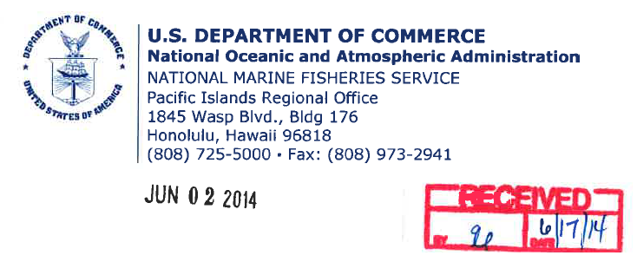
What are examples of Federal Consistency in the CNMI?
DCRM regularly checks federal agency actions to ensure they are consistent with the CNMI’s Coastal Management Program
Recently, DCRM discussed the MITT with the Department of Defense to ensure its compliance

Slide 9
Do I need to apply for Federal Consistency?
Please see our Procedures Guide for Achieving Federal Consistency with the CNMI Coastal Management Program (coming soon!)
Or, Contact our Federal Consistency Specialist
megan.jungwi@crm.gov.mp

Slide 10
Where can I find out more about Federal Consistency?
Please see our Procedures Guide for Achieving Federal Consistency with the CNMI Coastal Management Program (coming soon!)
Or, Contact our Federal Consistency Specialist
megan.jungwi@crm.gov.mp

