Slide 1
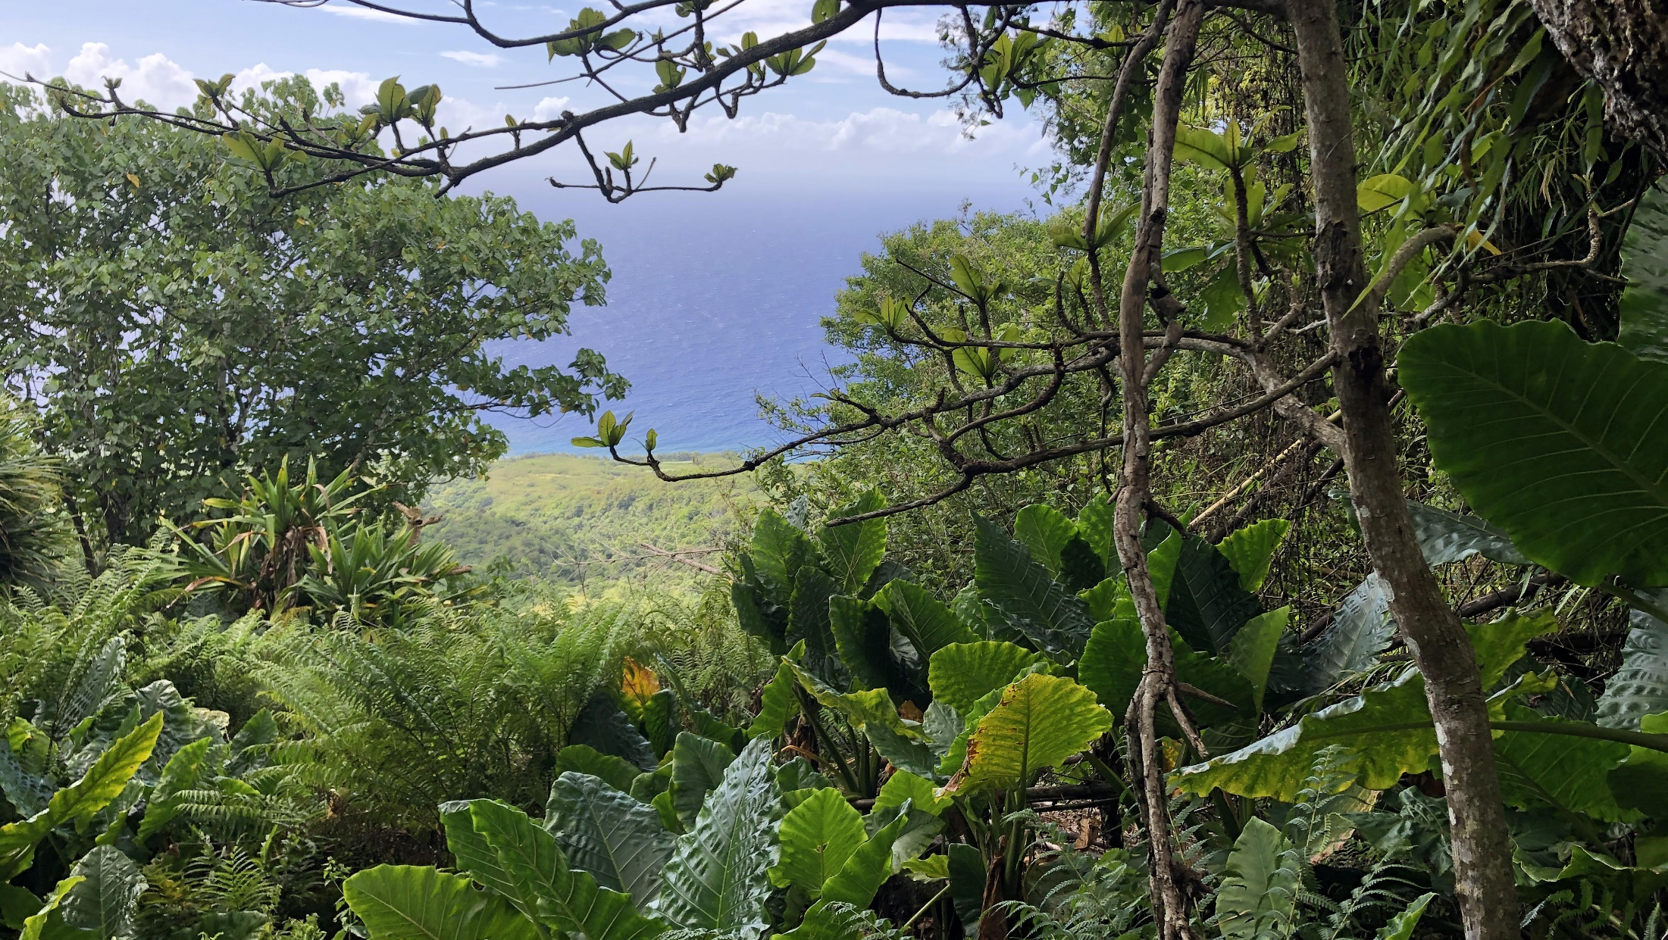

Watershed Working Group (WWG)
February 23, 2021 Quarterly Meeting

Slide 2
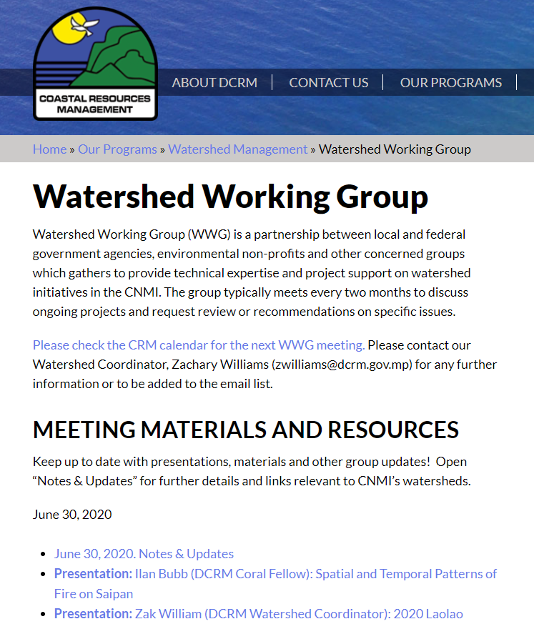
The Watershed Working Group is a network of partners involved in watersheds planning, project implementation, research, and education.
Includes members from local and federal government agencies, NGOs, community groups, and other interested parties.
Typically meets quarterly to discuss issues relating to watersheds, in order to pool knowledge and networks towards better management and collaboration.
https://dcrm.gov.mp/our-programs/water-quality-and-watershed-management/watershed-working-group/

Slide 3

Meeting Agenda
Zak Williams (BECQ-DCRM)
  Garapan and Talakhaya Watershed Management Plans (WMP) updates
Pam Sablan, Chad Cherefko, Jedidiah Dunn (USDA-NRCS)
  Targeted Conservation Delivery (TCD) overview
  CNMI issues identification & priority-setting
Becky Skeele (Koa Consulting)
  Updates on Achugao WMP development (Interim Report)
  Priority-setting
Ilan Bubb (BECQ-DCRM)
  Achugao reforestation overview
  Reforestation siting input
Olivia Tenorio (BECQ-DEQ)
  Storm drain catchment pilot program
Roundtable Discussion
  Member updates, concerns, opportunities, etc.
Closing

Slide 4
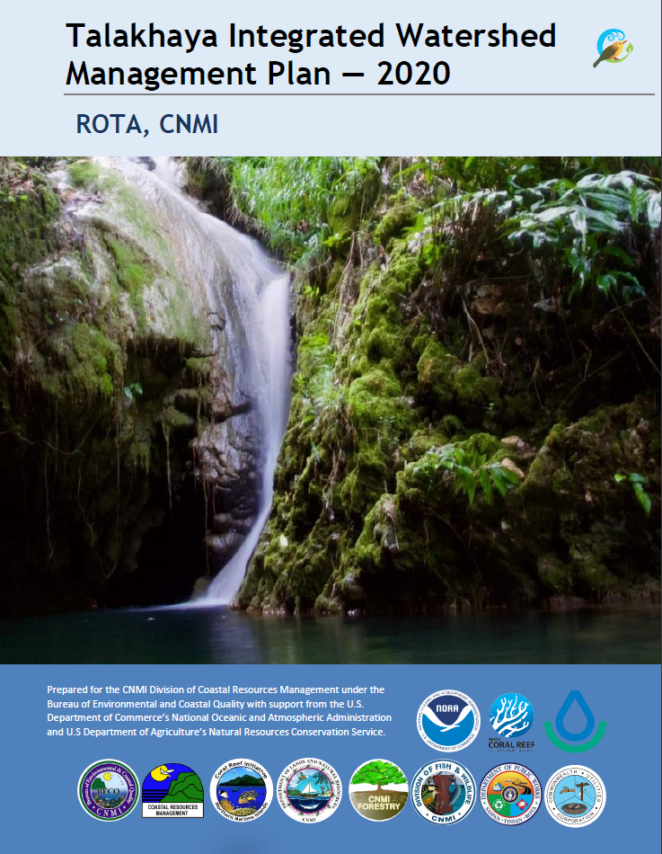

2020 CNMI Watershed Management Plan (WMP) Update — Talakhaya
https://opd.gov.mp/wp-content/uploads/opd/Talakhaya-2020-WMP_final-internal-draft.pdf
Notes:
Conservation Action Plan (CAP) written in 2012 (updated 2015).
CAP challenges: i) lack of key agency participation, ii) lack of progress monitoring, iii) lack of coordination (Watershed Coordinator turnover).
Notable CAP accomplishments:
Talakhaya Revegetation Project (started 2007)
Leveraged funding through grants that referenced CAP
Talakhaya Watershed Soil Loss Assessment
Infrastructure improvements (e.g. road repair)
Field agents
Reduced fires and other illegal activities
Outreach & Education Campaigns
e.g. “Real Hunters Don’t Burn”

Slide 5
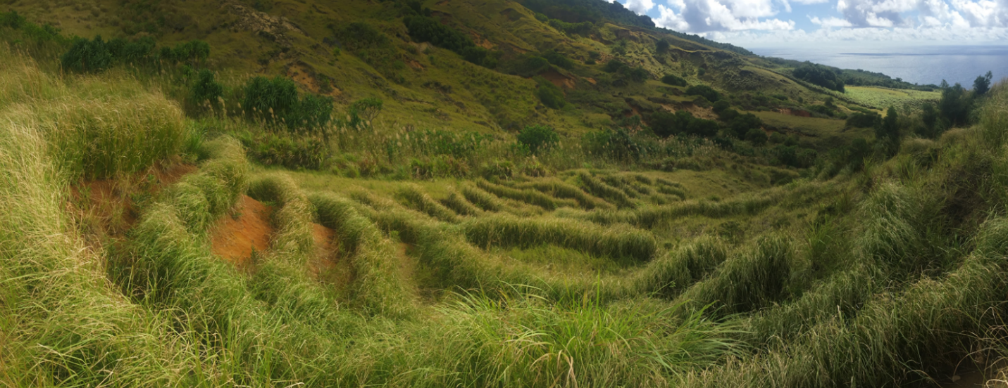
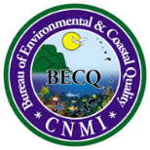

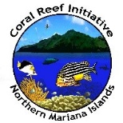
“Protehi i rikesan i tano yan i tasi” – “Protect the wealth of our land and sea”
Notes:
“Protehi i rikesan i tano yan i tasi” – “Protect the wealth of our land and sea”

Slide 6
10-Year Goals
  Equitable distribution of watershed values.
  Dedication to restoration of the landscape.
  Increased knowledge of watershed systems.
  Reduction of erosion and sedimentation.
  Commitment to meet future water needs.
  Raised community awareness of watershed.
  Improved monitoring and evaluation of the watershed area.
Improved land management and enforcement in cooperation with local agencies and landowners of both the Sabana Wildlife Conservation Area and Talakhaya Conservation Area.
Continued support of Forestry revegetation efforts of badlands and expansion towards native reforestation.
Increased understanding of the geomorphology of the watershed to better inform strategic actions and ensure effective issue response.
Enhanced stabilization of roads and culverts to reduce sedimentation and improve access of Talakhaya for both landowners and the revegetation project.
Bolstered collaboration with CUC and DPW to identify, monitor, and evaluate current and future water resources within the Talakhaya/Sabana watershed.
Raised community awareness and educational outreach for both the planning process and the Talakhaya watershed more generally.
Improved monitoring of watershed processes through the development of unified monitoring plans and partnerships.
5-Year Objectives
Notes:
Key Threats:
Ungulate Populations
Invasive Species
Private Land Access
Agricultural Practices
Burning/”Wild” Fire
Climate Change

Slide 7
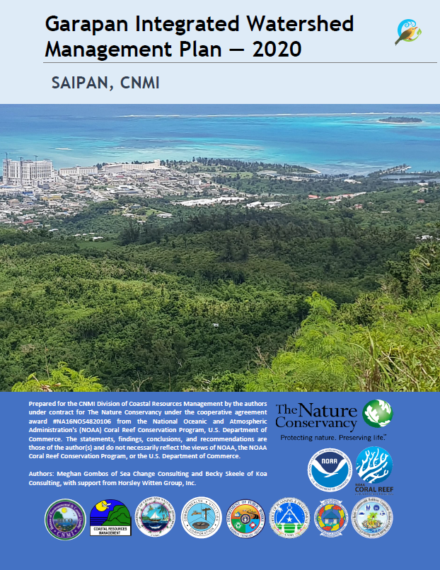
2020 CNMI Watershed Management Plan (WMP) Update — Garapan
https://opd.gov.mp/wp-content/uploads/opd/Garapan-WMP_final-internal-draft.pdf
Notes:
Conservation Action Plan (CAP) written in 2013 (updated 2015).
CAP challenges: i) lack of key agency participation, ii) lack of progress monitoring, iii) lack of coordination (Watershed Coordinator turnover).
Notable CAP accomplishments:
Infrastructure improvements (e.g. stormwater collection)
Illicit discharge detection and elimination grogram
Leveraged funding through grants that referenced CAP
Outreach & Education Campaigns
e.g. “Watershed Warriors”
Installation of CNMI Museum raingarden
New legislation passed to fine littering
Removal of junk cars
Cash-for-Trash Program
Climate change components integrated into marine monitoring program
Tour guide certification program now required and curriculum developed

Slide 8
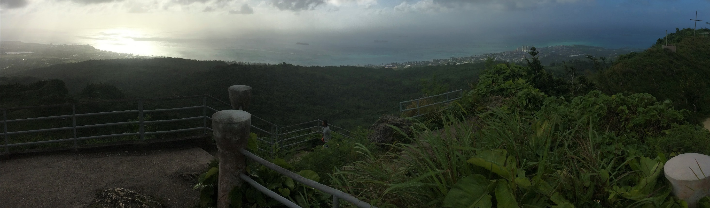
The Garapan watershed is the CNMI’s “Hafa Adai” and “Tirow” to the world. Garapan is the convergence of our economic, natural and cultural resources. It provides our community with safe and healthy resources to engage in and share with our visitors. It is thriving and resilient to the impacts of climate changes through smart, safe, development and actions from ridge-to-reef.
Notes:
The Garapan watershed is the CNMI’s “Hafa Adai” and “Tirow” to the world. Garapan is the convergence of our economic, natural and cultural resources. It provides our community with safe and healthy resources to engage in and share with our visitors. It is thriving and resilient to the impacts of climate changes through smart, safe, development and actions from ridge-to-reef.

Slide 9
10-Year Goals
Improved lagoon water quality
Improved management of Critical Habitat (i.e. wetlands, seagrass, reef, forest)
More sustainable and resilient development
20 green infrastructure or stormwater mitigation projects have been implemented through a pilot program that provides funding and technical assistance to homeowners or businesses.
3 sustainable designed public restroom facilities will be open, maintained, and available for public use during regular daytime hours.
High priority individual waste disposal systems (IWDS) have been identified and 10% of inspected sites repaired.
Illicit discharge has been detected and removed in at least 30% of the watershed area through the implementation of an inspection program for illicit discharge detection and elimination (IDDE).
Fats, oils, and grease (FOG) disposal program is established and implemented.
A minimum of two affordable spay/neuter clinic events are completed in Garapan.
DFW hunting, fishing, and research permit regulations have been reviewed and updated with legal guidance.
Guidance on BMPs for invasive species/vegetation developed and integrated into agency-specific permitting and enforcement processes.
DCRM will update NMIAC 15-20 (jet ski regulations) to encompass all marine sports operations (MSO).
All development projects incorporate Smart, Safe Growth (SSG) principles through the application of the SSG Project Review Matrix.
Major siting permitting decisions include the Zoning Board.
A central portal for public spatial data is established and used for planning, permitting, and decision-making.
The Garapan Revitalization Taskforce and Watershed Working Group have an action plan based on the Horsley Witten (HW) Model to manage at least 50 acres of drainage area (in Garapan watershed) to address stormwater impacts through new structural stormwater BMPs, including a 10% average reduction in impervious cover and in turf by 2030.
5-Year Objectives
Notes:
Key Threats:
Bacterial Contamination
Non-bacterial Polluted Runoff
Native Wildlife Population Decline
Invasive Species
Illegal Harvest

Slide 10
Need to move forward with signing.
Signing “ceremony” meeting vs. passing document around to individual signees?

Slide 11
NRCS TCD Presentation

Slide 12
Feedback Requested
Targeted Conservation Delivery (TCD) Overview: https://dcrm.gov.mp/wp-content/uploads/crm/TCD-Pitchbook.pdf
Priority-Setting Board: https://dcrm.gov.mp/wp-content/uploads/crm/NRCS-Priority-Setting-Board.pdf
Please send feedback regarding natural resource issues, opportunities, or other questions/comments to Pam Sablan (Pamela.Sablan@usda.gov), Jebidiah Dunn (jedidiah.dunn@usda.gov), or Chad Cherefko (chad.cherefko@usda.gov).

Slide 13
Achugao Update Presentation

Slide 14
Feedback Requested
Achugao Interim Report: https://dcrm.gov.mp/wp-content/uploads/crm/201215_Achugao_Existing-Conditions-and-Opportunities.pdf
Appendix A, Field Forms: https://drive.google.com/file/d/1kGSU22z4rq5eo8_aRvaaBi0-7ANNzSL6/view?usp=sharing
Horsley Witten online mapping of drainage infrastructure & potential project sites: https://arcg.is/j1eqD0
Please send feedback regarding projects priority-setting, additional project ideas, or other questions/comments to Becky Skeele (becky@koaconsultingllc.com), Anne Kitchell (akitchell@horsleywitten.com), and/or myself (zwilliams@dcrm.gov.mp).

Slide 15
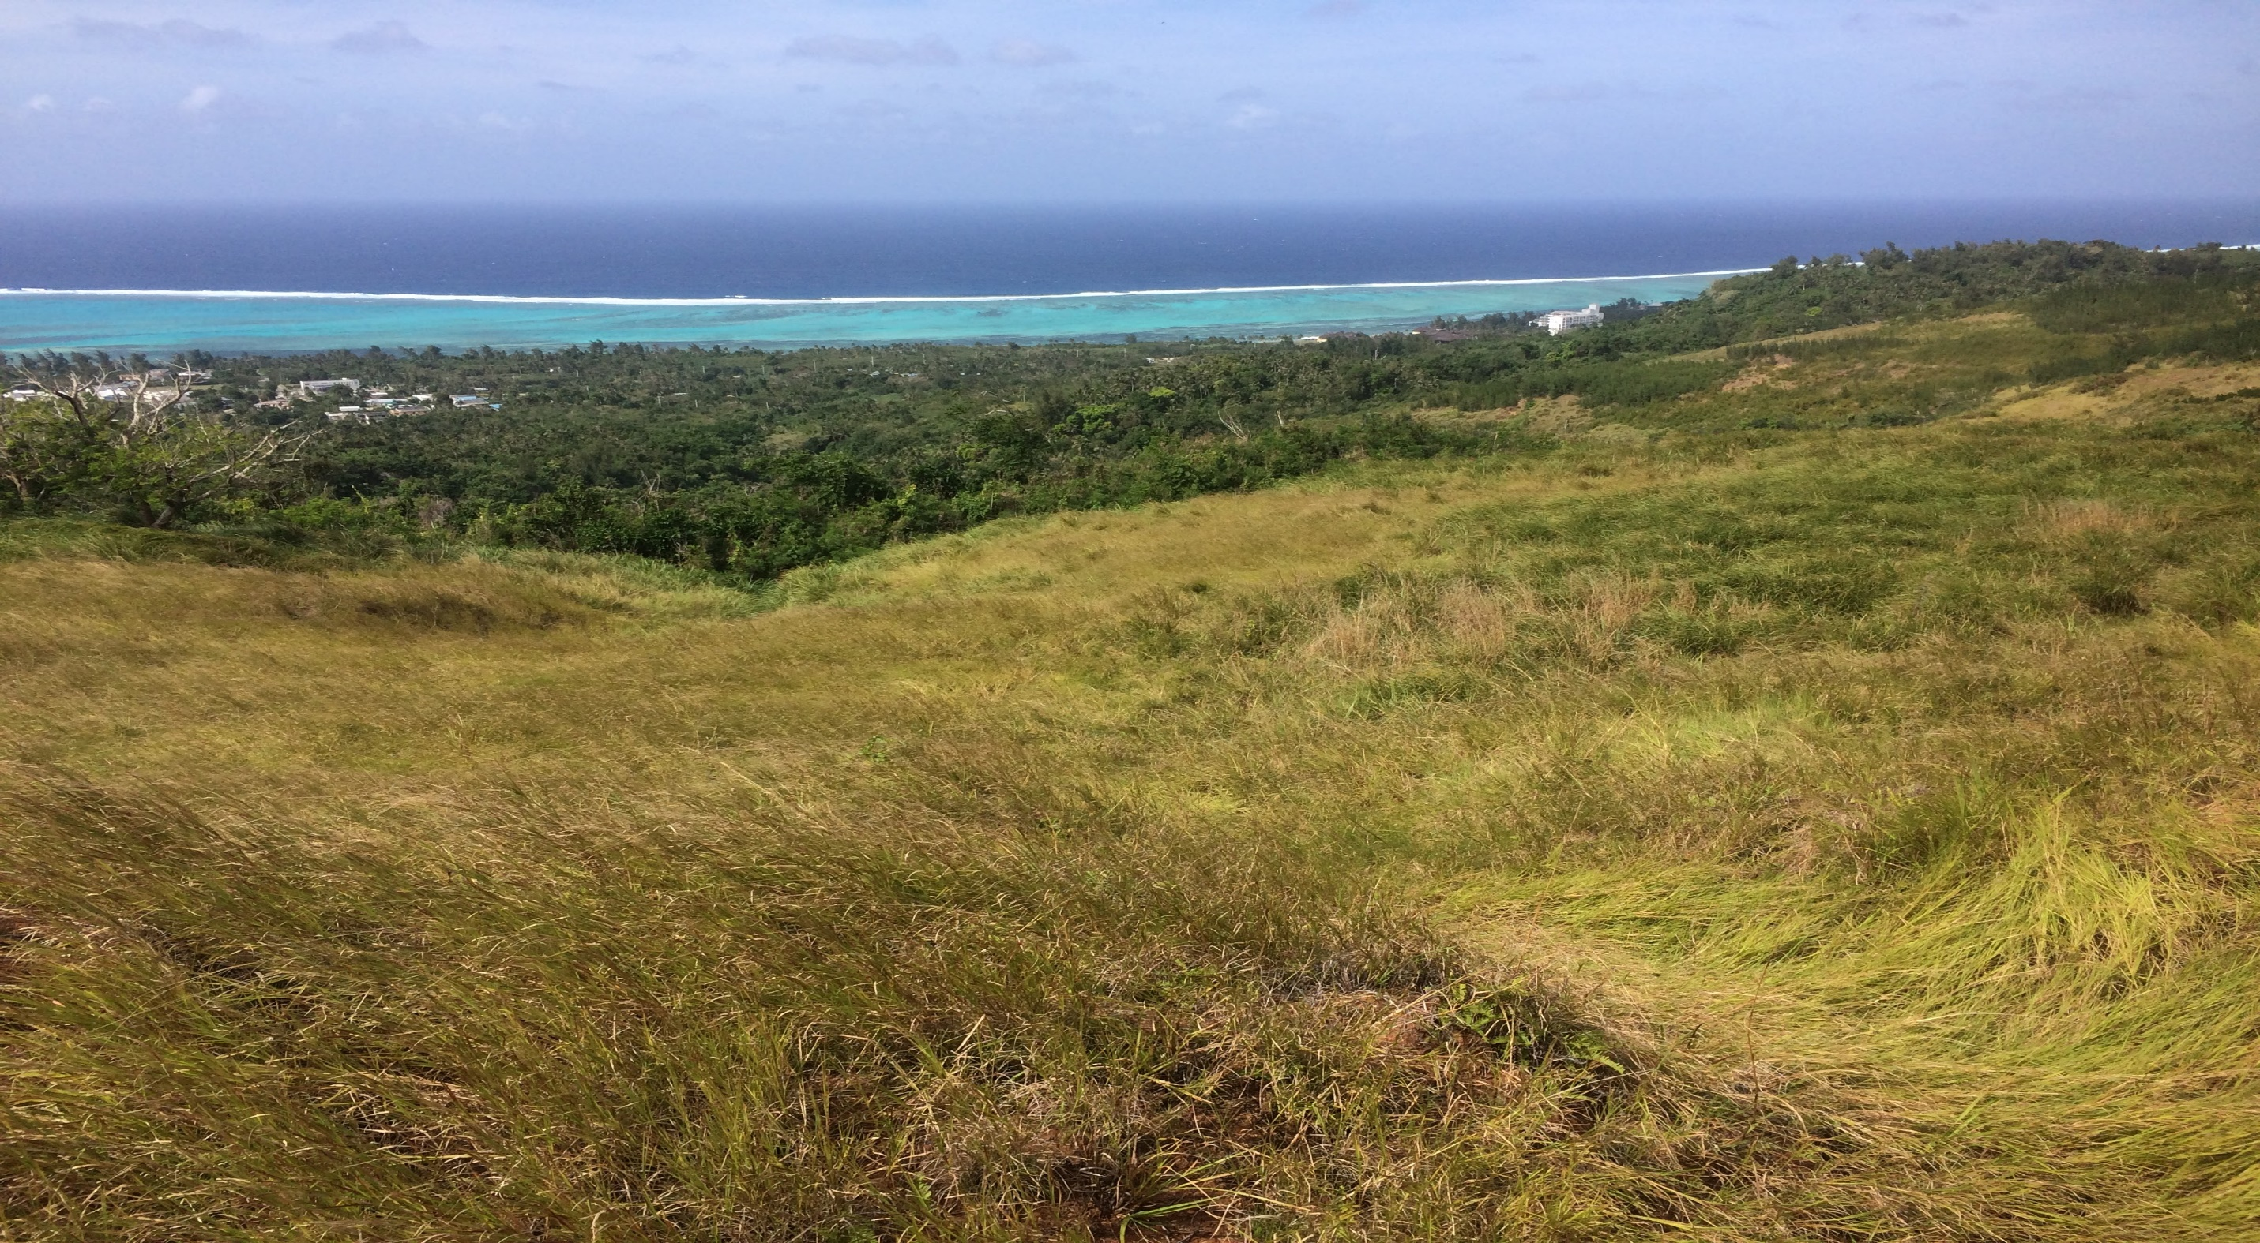
Wireless Ridge Revegetation
Notes:
Other presenters

Slide 16
Quick Intro
DOI grant has provided funding for revegetation in Achugao Watershed
MINA has been selected to recruit three part-time employees to aid in efforts.
Forestry will be providing support through propagation of target vegetation species
Goal is to restore six acres of vegetation in the “bell”

Slide 17
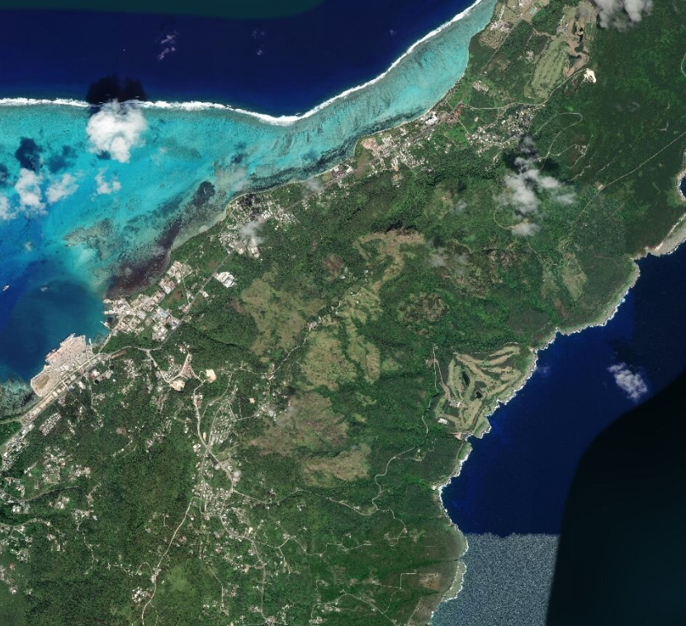
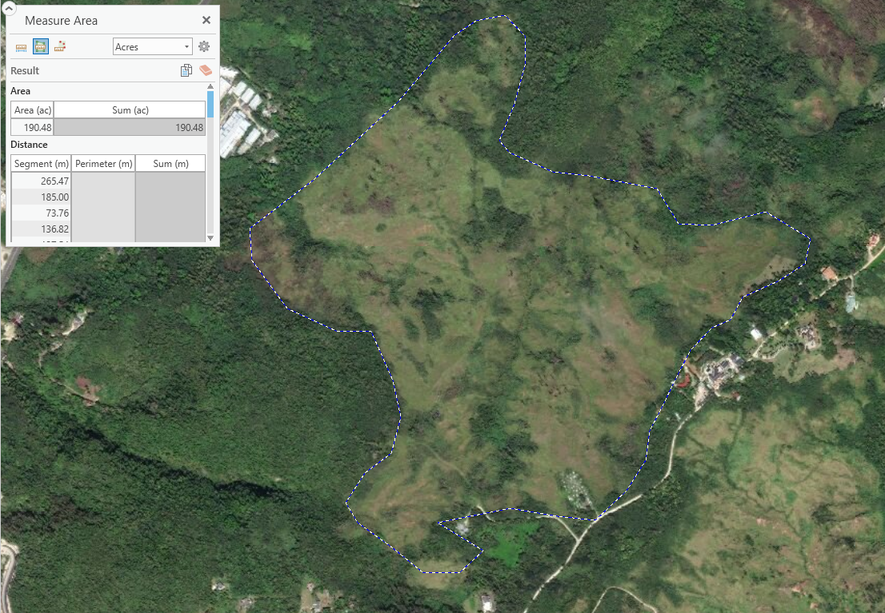
The Bell

Slide 18
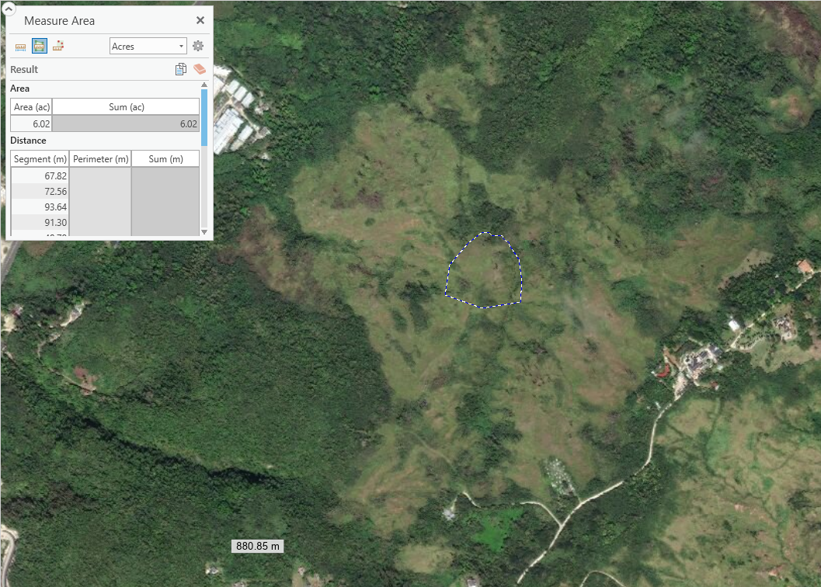
The Bell

Slide 19
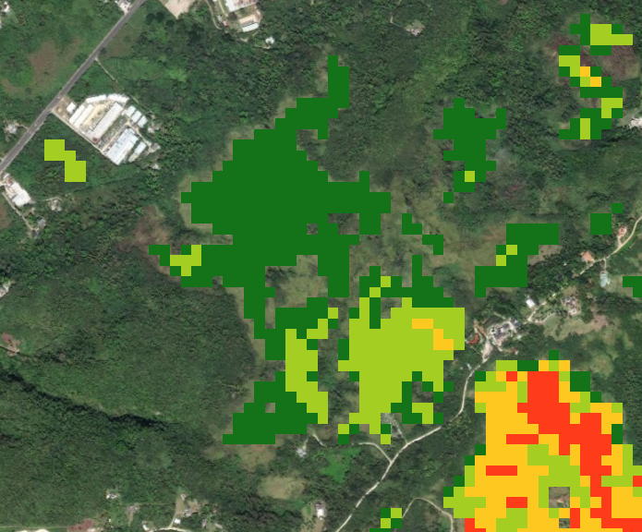
Concerns
Endangered Species Habitat
Historic Preservation Areas
Private land (pretty much entire area is public)
Public use (hunting)
Access
Having the biggest impact
UXOs…
Fire mapping of the bell

Slide 20
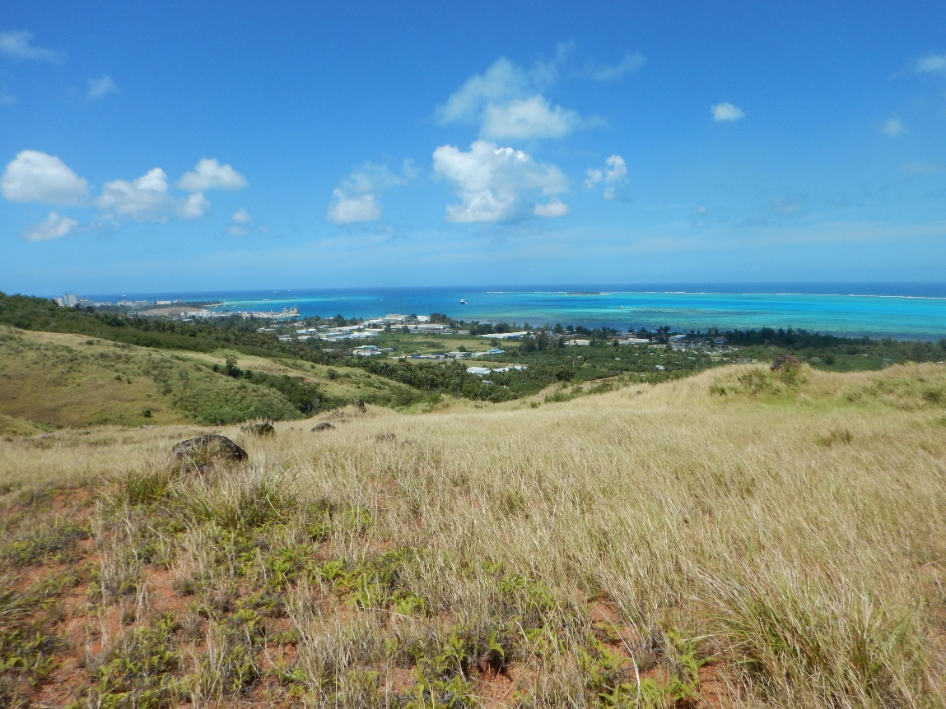
What We are Looking For
Advice for specific people that we should talk too
Suggestions for engaging community in discussion
Other things we might have missed

Slide 21
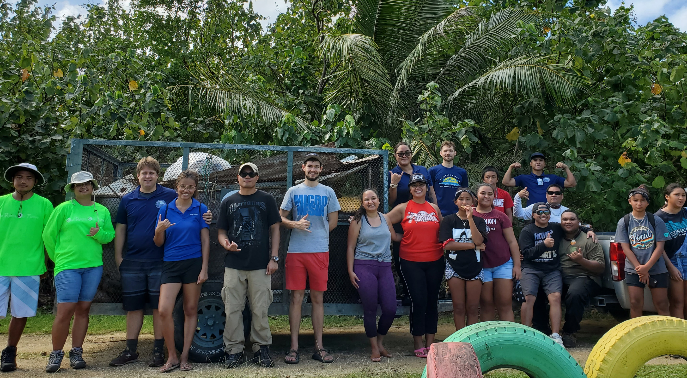
Notes:
Other presenters

Slide 22
Roundtable
Updates, concerns, opportunities?
Department of the Interior (DOI) grants available → close April 2021
  Coral Reef & Natural Resources (CRNR) Program
  Technical Assistance Program (TAP)
  Maintenance Assistance Program (MAP)
  https://www.grants.gov/web/grants/search-grants.html?keywords=15.875
2021 Pacific Islands GIS & RS User Intermediate Conference
  Today and tomorrow (?)
  Agenda: picgisrs.org/2021-intermediate-conference/
  Zoom link: https://usp-fj.zoom.us/j/88346123954
DCRM Better Buildings Guidance Stakeholder Questionnaire
  https://forms.gle/9p9S7mLyfsJDYbCY7
Notes:
Not sure about the time for the conference, time zone not given in schedule.

Slide 23
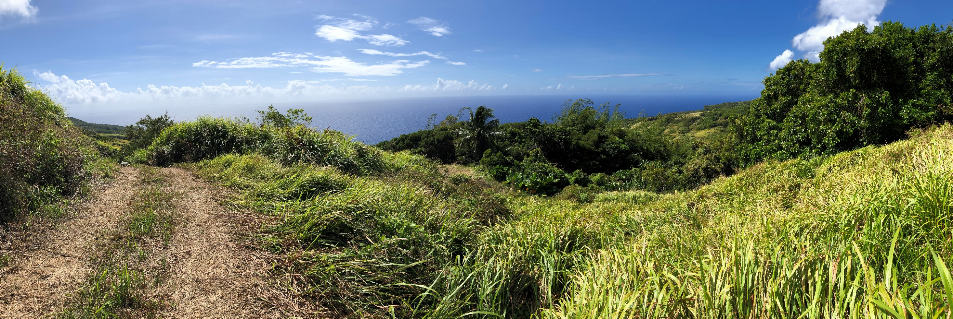
Thank you!
Zachary B. Williams ׀ Watershed Coordinator (BECQ-DCRM-CRI)
zwilliams@dcrm.gov.mp ׀ (670) 664-8303

